Slide 1
SPORTS CLUB SYSTEM
Sport Club is a Web Application developed for booking and managing of sports booking data and their related activities.

Slide 2
1.INTRODUCTION
Sports Club Management System is software developed for daily usage of users for booking the playgrounds.
It facilitates to access the sports which are available, booking and manage them.
The information is stored in database and can be easily accessed.
In short, this project is used to book the sports, provides managing the booking activities and displays the graphs for all booking data and helps the organize the data, provides the better booking experience and many more.

Slide 3
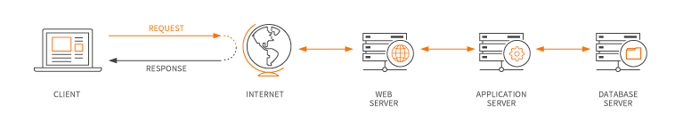
Web Application
​A web application is a computer program that utilizes web browsers and web technology to perform tasks over the Internet

Slide 4
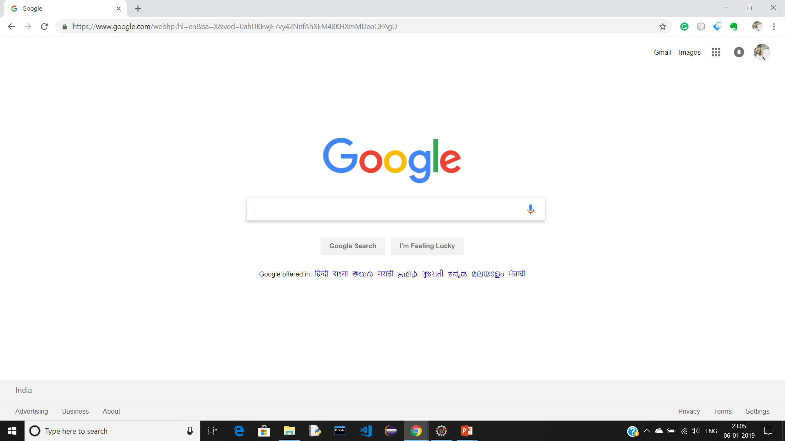






Working of Web Application
Requesting Data from DB
Request
www.google.com
Data Retrieving
Server Response
Client
Server
Database
Front-End:-
HTML, Java Server Page (JSP)
CSS
JAVA SCRIPT (Client Side Scripting)
BOOTSTRAP
Back-End:-
JAVA
Web Server:-
APACHE TOMCAT SERVER 7.0
Database:-
MySQL

Slide 5
Source Code:
To view source code follow the GitHub repository
GitHub repository link : https://github.com/itsmrajesh/Sports-Club

Slide 6
Thank You

